Slide 1
Shortest Path Algorithms

Slide 2
Shortest Path Problem
The shortest path problem is about finding a path between vertices in a graph such that the total sum of the edges weights is minimum.
A shortest path from vertex ‘s’ to vertex ‘t’ is a directed path from ‘s’ to ‘t' with the property that no other such path has a lower weight.

Slide 3
Single Source Shortest Path
When a shortest path is calculated from a single vertex (node) to all other vertices in the graph.
Multiple Source Shortest Path
  When a shortest path is calculated between any pair of vertices in the graph.

Slide 4
EXAMPLE (Single Source)
Consider a directed, weighted graph
F
3
C
10
A
4
3
8
4
2
B
6
D
5
4
H
2
1
3
G
E
3

Slide 5
EXAMPLE (Single Source)
Source
F
3
C
10
A
4
3
8
4
2
B
6
D
5
4
H
2
1
3
G
E
3
Suppose, A is the source node and we are interested in finding the shortest path between A and B. So, there exists 2 paths from A to B:- (i) Direct path from A to B which costs ‘8’ and (ii) Path from A to B via H which costs ‘7’.
Hence, we prefer a path with minimum cost, thereby choosing a path via H.

Slide 6
EXAMPLE (Multiple Source)
F
3
C
10
A
4
3
8
4
Destination
5
B
6
D
2
4
H
2
1
3
G
E
3
Source

Slide 7
Algorithms
Single Source Shortest Path
  Dijkstra’s Algorithm
  Bellman Ford Algorithm
Multiple Source Shortest Path
  Floyd Warshall Algorithm
    Note*- All algorithms are applicable on directed and weighted graphs only.

Slide 8
Dijkstra’s Algorithm
Very much similar to Prim’s Algorithm for MST
We maintain two sets, one set contains vertices included in shortest path tree
Other set includes vertices not yet included (visited) in shortest path tree.
At every step of the algorithm, we find a vertex which is not yet included (visited) and has a minimum distance from the source.

Slide 9
Algorithm
1) Create a set sptSet (shortest path tree set) that keeps track of vertices included in shortest path tree, i.e., whose minimum distance from source is calculated and finalized. Initially, this set is empty.
2) Assign a distance value to all vertices in the input graph. Initialize all distance values as INFINITE. Assign distance value as 0 for the source vertex so that it is picked first.
3) While sptSet doesn’t include all vertices
….a) Pick a vertex u which is not there in sptSet and has minimum distance value.
….b) Include u to sptSet.
….c) Update distance value of all adjacent vertices of u. To update the distance values, iterate through all adjacent vertices. For every adjacent vertex v, if sum of distance value of u (from source) and weight of edge u-v, is less than the distance value of v, then update the distance value of v.

Slide 10
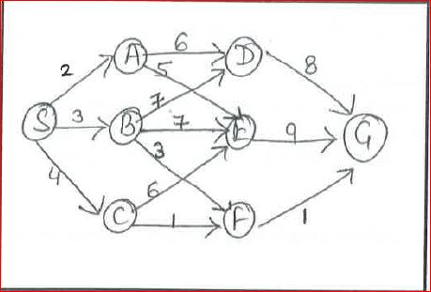
EXAMPLE

